Slide 1
Comprehensive Digital Marketing Project Work on ICICI BANK
Team members:
1. G. Sai Keerthika
2. B. Lokeswari
3. B. Suresh
4. P. Nabila

Slide 2
Part:1 Brand study, Competitor Analysis & Buyer’s/Audience’s Persona

Slide 3
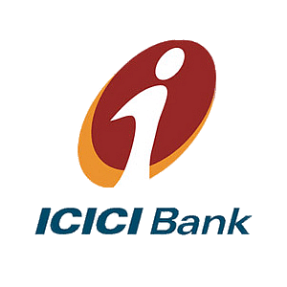
COMPANY/TOPIC for project: ICICI BANK
*RESEARCH BRAND IDENTITY: Study the brand’s mission, values, vision, and unique selling proposition(USPs).
* BRAND COLOURS: white, orange, red
* LOGO:
* MISSION/VALUE:ICICI will leverage our technology, and financial capital:
*Be the banker of the first choice for our customers by delivering high quality, world-class products, and services
*Expand the frontiers of our business globally
*Maintain a healthy financial profile and diversify our earnings across business and geographies
* USP: ICICI is the most efficient and tech savvy bank in the Indian banking industry and settle claims within a defined period of time.
* TAGLINE: “HUM HAIN NA”

Slide 4

Part1: Brand Study, Competitor Analysis & Buyer’s/Audience’s Persona
*ANALSE BRAND MESSAGE:
ICICI Group offers a wide range of banking products and financial services to corporate and retail customers through a variety of delivery channels and through its specialised group companies, and affiliates in the areas of personal banking, investment banking life and general insurance, venture capital and asset management
*EXAMINE THE BRAND’S TAGLINE:
A tagline or slogan is a memorable motto or phrase used in a clan, political, commercial, religious, and other context as a repetitive expression of an idea or purpose, with the goal of persuading members of the public defines target group.
ICICI bank tagline is ‘’ HUM HAIN NA ‘’. ICICI Bank prepared his own list of bank slogan and punchlines. By roughly translated in English, it’ s like “I see you” which means we are here!
*Example:
https://instagram.com/icicibank?igshid=MzRlODBiNWFlZA

Slide 5
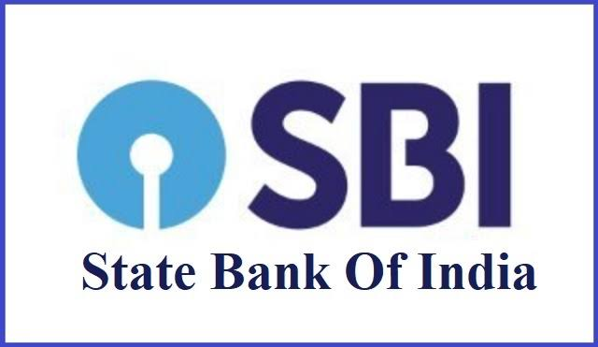
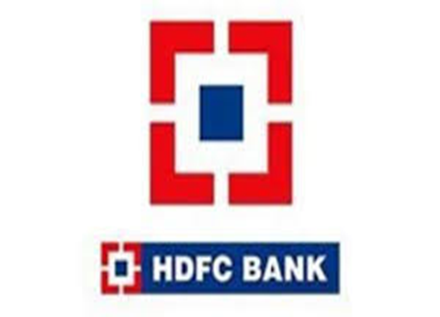
Buyer’s/Audience’s Part1: Brand Study, Competitor Analysis & Persona
*COMPETITOR ANALYSIS:
Select three competitors operating in the same industry as the chosen brand, examine their USPs and online communication
*Competitor 1: https //www.sbi.co.in login
*USP: SBI is a type of bank which every Indian can trust
*Communication: Last-mile communication to the customers by most use of SBI owned platforms-website, Emailers, social media, ATMs and through the vast network of our bank circles & SBI bank branches.
*Competitor 2: https //www.hdfc.com login
*USP: HDFC bank is one of the big four banks India
*Communication: Last-mile communication to the customers by most use of HDFC owned platforms-website, Emailers, social media, ATMs and through the vast network of our bank circles & HDFC bank branches.

Slide 6
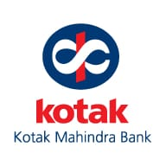
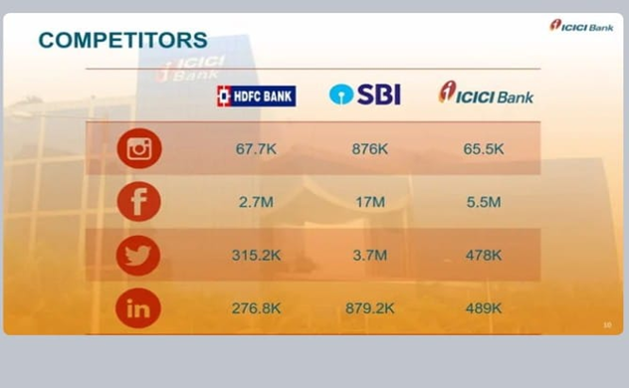
*Competitor 3: https //www.kotak Mahindra bank.com login
*USP: Professionalism in banking and it is the higher interest rate for its saving bank accounts at 6%
*Communication: Last-mile communication to the customers by most use of HDFC owned platforms-website, Emailers, social media, ATMs and through the vast network of our bank circles & HDFC bank branches. Also, almost instant dissemination of essential information, announcements to the National Media.

Slide 7
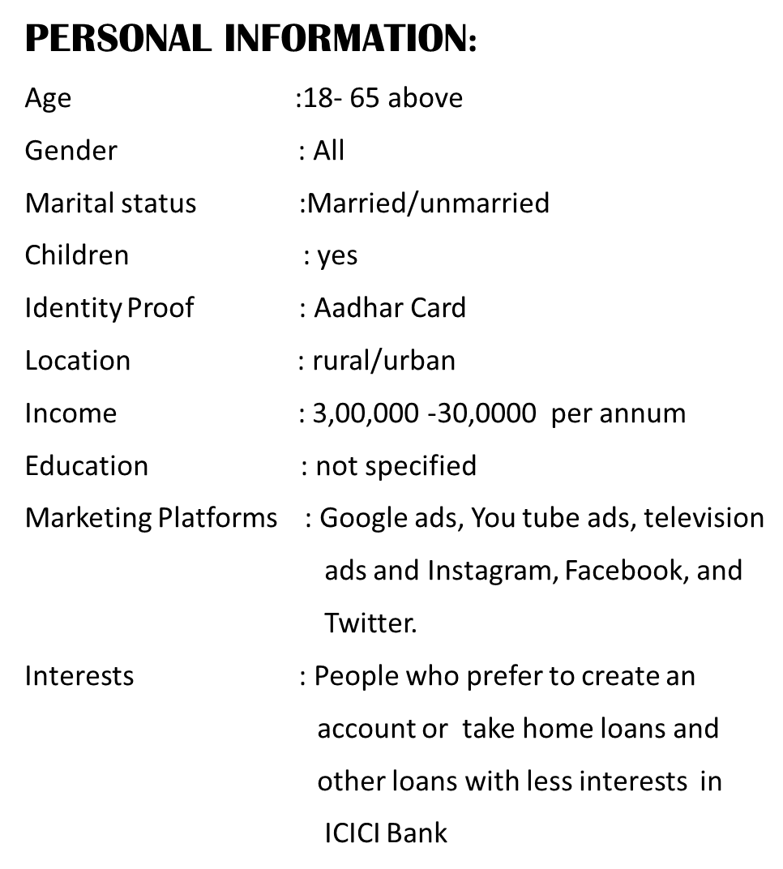
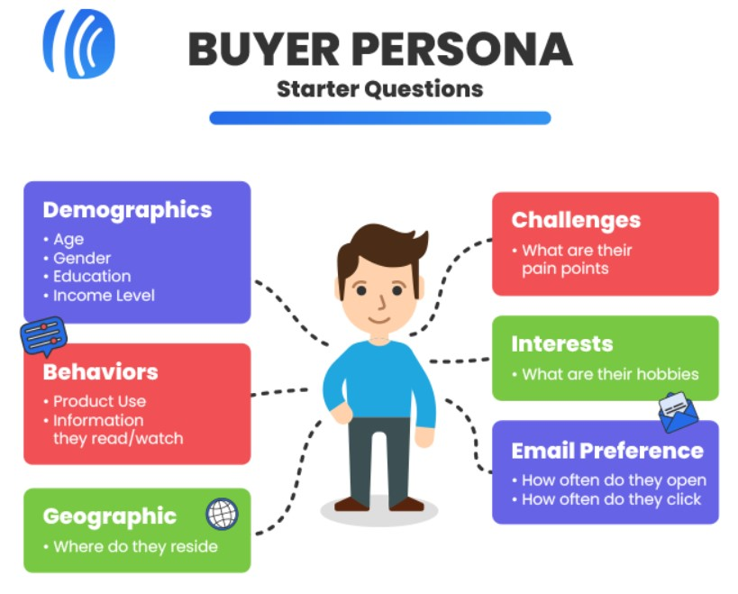
Part1: Brand Study, Competitor Analysis & Buyer’s/Audience’s Persona
*BUYER’S/AUDIENCE’S PERSONA:
Clearly define the target audience for the ICICI Bank. Let’s consider the following information

Slide 8


Slide 9
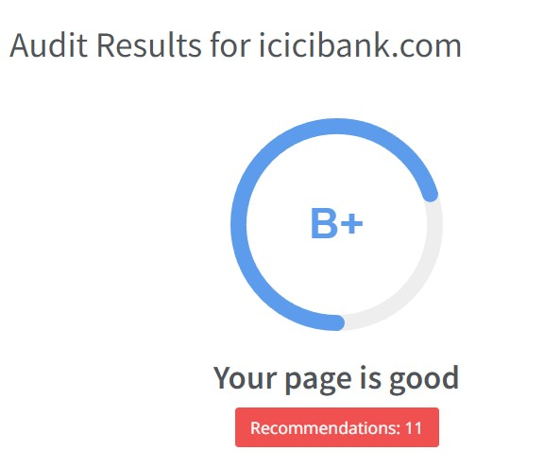
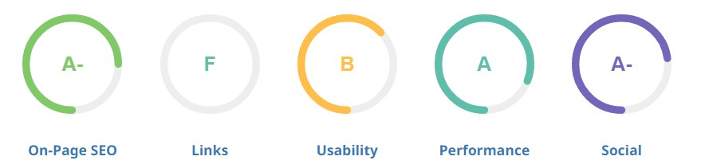
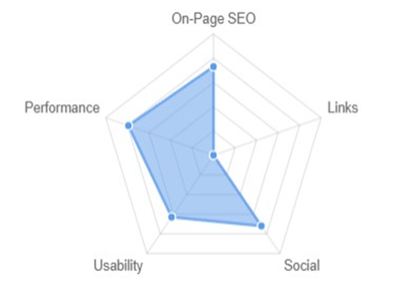
*PART 2: SEO & KEYWORD RESEARCH
*ICICI BANK SEO AUDIT:
An SEO audit is the evaluating how well our website is optimised for search engines identifies errors that can prevent your site from ranking well and opportunities that can help you rank better. An SEO audit usually covers areas like indexing and crawlability
An SEO audit the process of analysing how well our web presents relates to best practises-it is the first step for creating an implementation plan that will have measurable results. The purpose of audit is to identity as many foundational issues affecting organic search performance as possible.

Slide 10
*RESEARCH OBJECTIVES:
Customer Experience Enhancement:
ICICI Bank, like any other financial institution, would likely focus on improving the overall customer experience. This could involve researching and implementing innovative digital banking solutions, user-friendly interfaces, and personalized services to attract and retain customers.
2.Digital Transformation:
To stay competitive and meet the evolving demands of tech-savvy customers, ICICI Bank might have been keen on digital transformation initiatives. Research in this area would involve exploring emerging technologies, such as AI, blockchain, and data analytics, to optimize operations and enhance services.
3.Risk Management and Fraud Detection:
Managing risks and ensuring robust fraud detection mechanisms are vital for any financial institution. ICICI Bank would likely have been conducting research to improve its risk assessment models, anti-fraud measures, and cybersecurity protocols to protect both the bank and its customers.
4.Financial Inclusion:
With the Indian government's focus on financial inclusion and digital payment systems, ICICI Bank might have been conducting research to reach underserved populations, exploring ways to expand banking services in rural areas and providing access to various financial products.
5.Product and Service Innovation:
Researching and developing new financial products and services is crucial for a bank's growth. ICICI Bank might have been exploring opportunities in areas such as wealth management, insurance, investment banking etc.

Slide 11
*BRAINSTROM SEED KEYWORDS:
Here are some of the brainstorm of seed keywords related to ICICI Bank:
ICICI Bank
Banking
Online Banking
Internet Banking
Mobile Banking
Credit Cards
Debit Cards
Savings Account
Current Account
Personal Loans
Home Loans
Car Loans
Fixed Deposits
Investment
Mutual Funds
Insurance

Slide 12
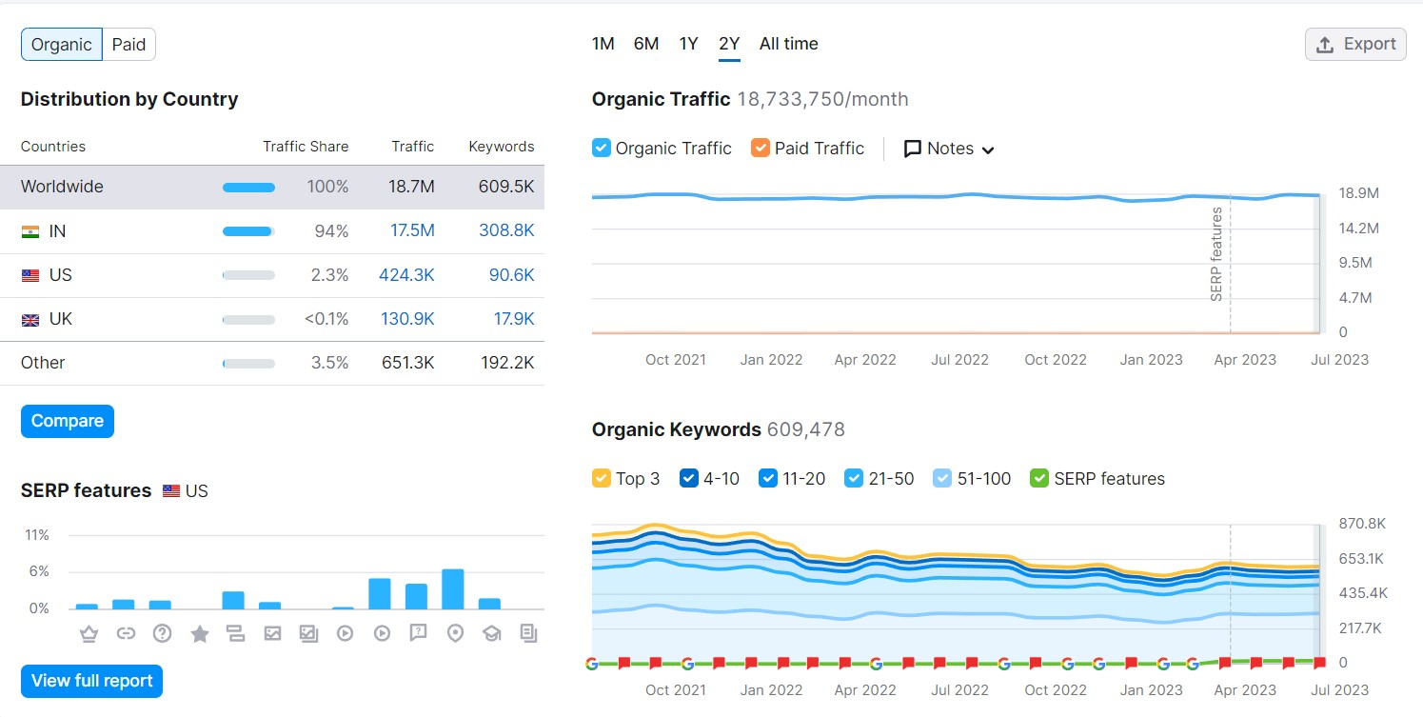
*KEYWORD RESEARCH:
Keyword research is the process of finding and analysing search terms that people enter into search engine with the goal of using that data for a specific purpose, often for search engine optimization (SEO) or general marketing
*Keyword Research for ICICI Bank:
The following are the relevant keywords of ICICI Bank that have been found after thorough research and filtering.
These keywords are further filtered as per the high and low traffic, popularity and few other criteria based on the requirement of our research.

Slide 13
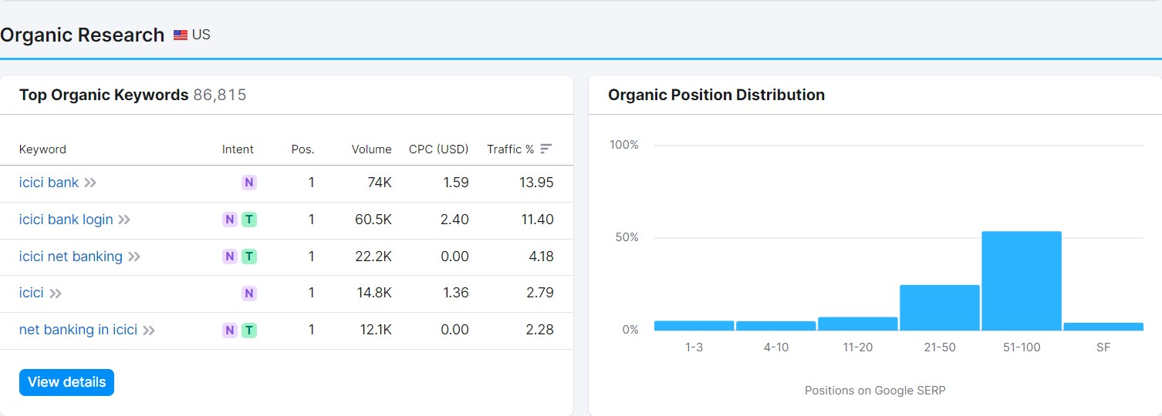
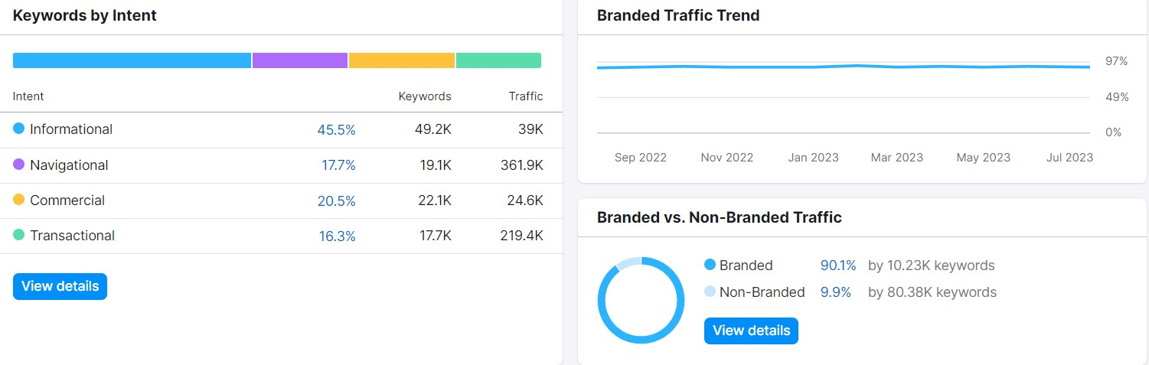

Slide 14
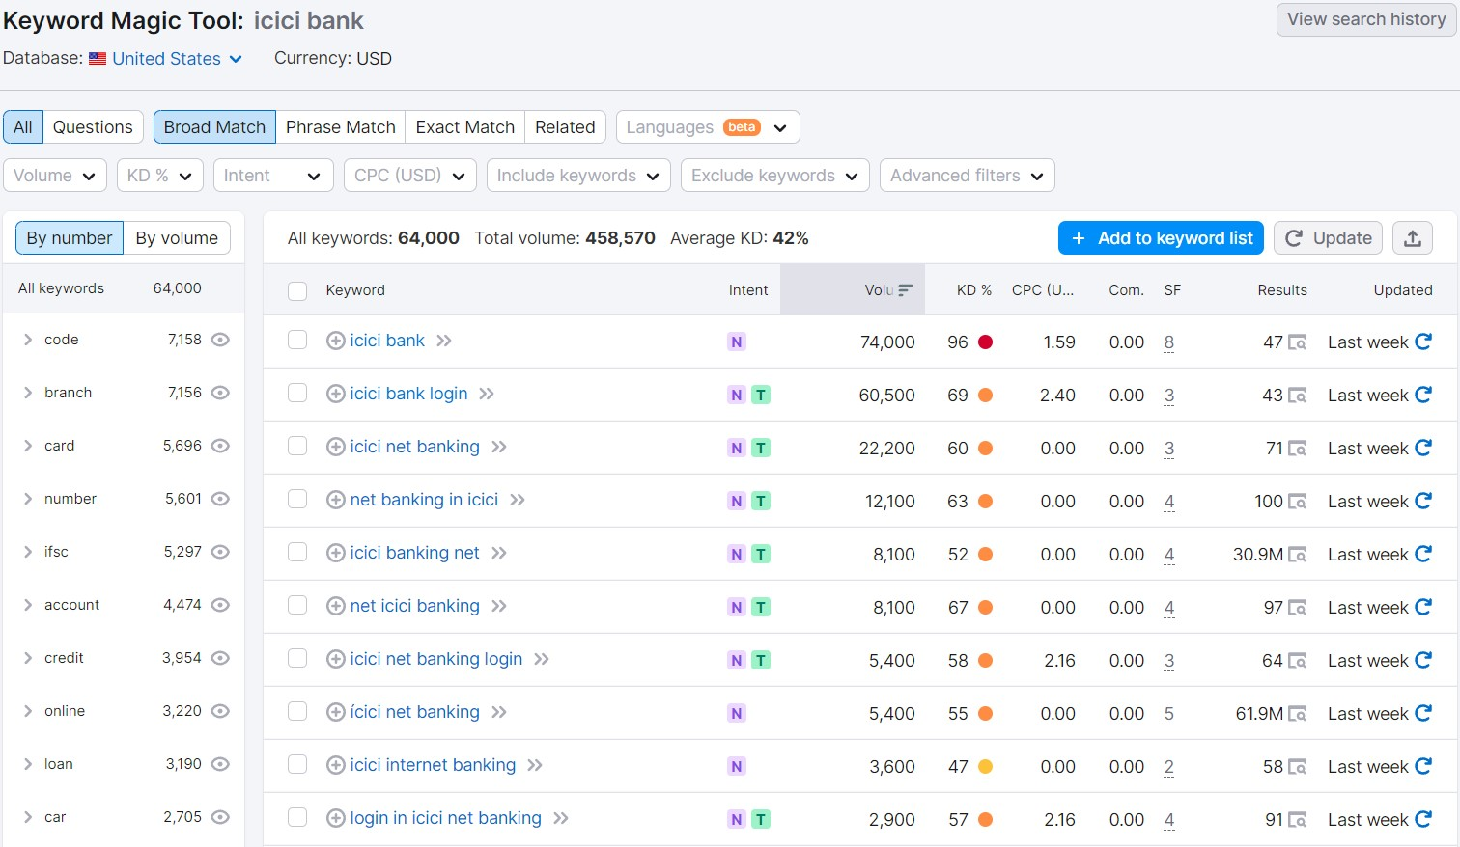
*ICICI BANK KEYWORDS:

Slide 15
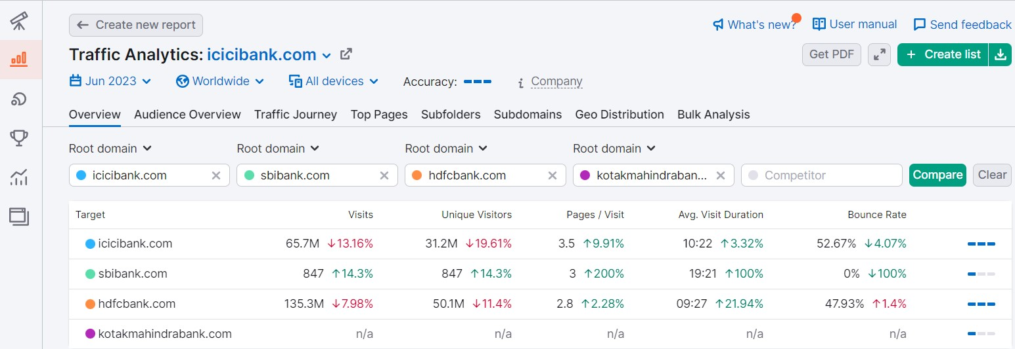
*ANALZE COMPETITOR KEYWORD

Slide 16
LONG-TAIL KEYWORDS SEARCH:
"ICICI Bank online banking login"
"ICICI Bank credit card rewards program"
"How to open an ICICI Bank savings account"
"ICICI Bank home loan interest rates 2023"
"ICICI Bank car loan eligibility criteria"
"ICICI Bank fixed deposit rates for senior citizens"
"ICICI Bank NRI banking services"
"ICICI Bank foreign exchange rates today"
"ICICI Bank money transfer charges"
"ICICI Bank branch locator near me"
"ICICI Bank customer service contact number"
"ICICI Bank investment options for beginners"
"ICICI Bank mutual funds performance review"
"ICICI Bank life insurance plans comparison"
"ICICI Bank business loan application process"
"ICICI Bank mobile banking app features"
"ICICI Bank net banking security tips"

Slide 17
*ON-PAGE OPTIMIZATION:
META TAG OPTIMIZATION FOR ICICI BANK:
1.Title Tag:
The title tag is one of the most crucial meta tags. It appears as the clickable headline in search engine results. Keep the title tag concise, within 50-60 characters, and include the brand name and primary keywords.
2.Meta Description:
The meta description provides a brief summary of the web page's content. Aim for 150-160 characters, and include relevant keywords and a compelling call-to-action to encourage clicks.
3. Open Graph (OG) Tags (Social Media Optimization):
Include Open Graph tags to control how your content appears when shared on social media platforms like Facebook, Twitter, and LinkedIn. Customize the title, description, and image to make the shared content more engaging.
Use the canonical tag to specify the preferred URL for a page with similar or duplicate content. This helps search engines understand the authoritative page and avoid duplicate content issues.

Slide 18
*CONTENT OPTIMIZATION FOR ICICI BANK:
Keyword Research:
Conduct thorough keyword research to identify relevant keywords and phrases related to ICICI Bank's offerings. Use tools like Google Keyword Planner or other SEO software to find high-traffic, low-competition keywords.
High-Quality and Unique Content:
Create original, informative, and valuable content that addresses the needs of ICICI Bank's target audience. Avoid duplicating content from other sources, as it can negatively impact search engine rankings
Optimize Page Titles and Meta Descriptions:
Craft compelling and keyword-rich page titles and meta descriptions. These elements appear in search engine results and significantly influence click-through rates
Structured Content with Headings:
Use clear and organized headings (H1, H2, H3, etc.) to break down content into sections. This makes it easier for users to scan and find relevant information quickly.
Internal Linking:
Incorporate internal links within the content to guide users to related pages on the website. This not only improves user experience but also helps search engines understand the website's structure

Slide 19
.
Visual Content:
Include relevant images, infographics, and videos to complement the text. Visual content enhances engagement and helps illustrate complex concepts.
Mobile-Friendly Design:
Ensure that the website and content are optimized for mobile devices. With a growing number of users accessing the internet on mobile, mobile-friendliness is crucial for user experience and SEO.
Calls-to-Action (CTAs):
Place clear and compelling CTAs strategically throughout the content. Encourage users to take desired actions, such as applying for products or contacting customer support
Local SEO Optimization:
If ICICI Bank has physical branches, optimize content for local searches. Include location-specific keywords and business information for better local search rankings.
Regular Updates:
Keep the content up-to-date with the latest information about products, services, interest rates, and any changes in policies.
Social Media Integration:
Incorporate social media sharing buttons to encourage users to share content on their social networks, increasing the content's reach and potential engagement

Slide 20
*PROCESS OF CONDUCTING KEYWORD RESEARCH:
Define Goals and Target Audience:
Start by defining the objectives of the keyword research. Understand the goals ICICI Bank wants to achieve through SEO, such as increasing website traffic, attracting potential customers, or promoting specific products. Identify the target audience and their search behaviour to tailor the keyword research accordingly.
2. Brainstorm Seed Keywords:
Begin the research process by brainstorming seed keywords related to ICICI Bank and its products and services. These are broad, general keywords that are relevant to the banking industry, such as "banking services," "credit cards“, "home loans," etc
3. Use Keyword Research Tools:
Utilize keyword research tools to expand the list of seed keywords and gather data on search volume, competition, and keyword variations. Some popular keyword research tools include Google Keyword Planner, SEMrush, Moz.
4. Competitor Analysis:
Analyse the keywords that ICICI Bank's competitors are targeting. Identify keywords they rank for and evaluate their performance. This analysis can provide insights into potential keyword opportunities and gaps.

Slide 21
5. Long-Tail Keyword Research:
Explore long-tail keywords, which are more specific and detailed phrases that reflect user intent. Long-tail keywords often have lower search volume but can lead to higher conversion rates and targeted traffic. Focus on keywords that are relevant to ICICI Bank's offerings and niche areas.
6. Keyword Grouping and Categorization:
Organize the collected keywords into relevant groups and categories based on their themes and relevance to ICICI Bank's products and services. This grouping helps in creating focused content for different keyword segments.
7. Analyse Search Intent:
Understand the search intent behind each keyword. Determine if users are looking for information, making a transaction, or seeking customer support. Align the keywords with appropriate landing pages that meet user intent.
8. Consider Local SEO (if applicable):
If ICICI Bank has physical branches or targets specific geographical regions, include location-based keywords to optimize for local searches. This can involve using keywords like "ICICI Bank Mumbai" or "best bank in Delhi."
9. Evaluate Keyword Difficulty and Potential:
Assess the competition and difficulty level of each keyword. Choose keywords that have a balance of decent search volume and relatively lower competition, giving ICICI Bank a better chance to rank higher.

Slide 22
10. Refine and Prioritize Keywords:
After analysing the data and insights, refine the keyword list and prioritize the most valuable keywords that align with ICICI Bank's objectives and target audience.
11. Create Content and Optimize Pages:
Develop high-quality and relevant content based on the selected keywords. Optimize website pages, meta tags, and headings to include these keywords natural
12. Social Media Integration:
Incorporate social media sharing and users to content on their social networks
13.Compliance and Transparency:
Clearly state terms and conditions, fees, and any legal or regulatory information to build trust with customers and adhere to industry standards.

Slide 23
Part 3 : Content ideas and Marketing Strategies

Slide 24
Part 3 : Content ideas and Marketing Strategies
*Content Calendar :
It is a written schedule and creating a content calendar for banks involves planning and scheduling various types of content to engage customers, promote services, and share relevant information.
Creating a content calendar for banks requires a thoughtful approach to engage customers, and establish the bank as a trusted financial resource.
*Aim :
The aim of the content calendar for ICICI Bank is to build brand awareness, increase customer engagement, educate users about financial matters, and drive leads for banking products and services.
*Idea :
The content calendar should be designed around the concept of “Financial Wellness”. This means creating content that helps customers manage their finances better, achieve their financial goals, and make informed decisions

Slide 25
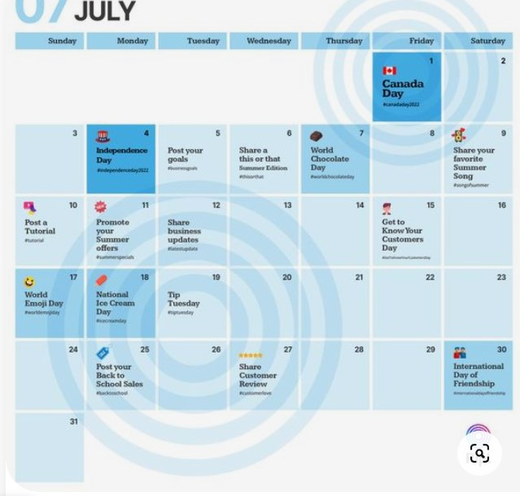

Slide 26
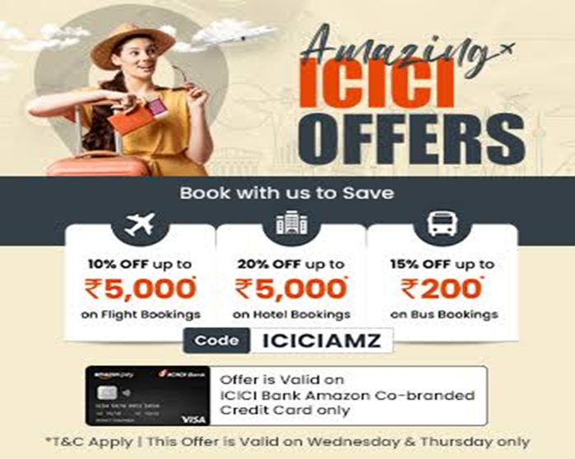
*Content idea Generation & Strategy :
Create a content calendar for the remaining month of July by brainstorming content themes, exploring various formats like blog post, videos, infographics, podcast, and interactive quizzes, and scheduling publication dates mainly on Facebook & Instagram
*The following are the some Social media content ideas for ICICI Bank
*Banking Schemes :
Banks can use social media to offer promotions and discounts to their customers, which can help to increase customer loyalty and drive business.
Social media is a great way for banks to promote new products and services to their customers. By posting about the benefits and features of these offerings, banks can attract new business and generate interests.
*Offers & Deal:
By sharing news about offers and deals, their products and services to potential customers. This can help to generate interest in the bank’s offerings and drive business. Offering exclusive deals and promotions to followers on social media, bank can encourage customer loyalty and retention

Slide 27
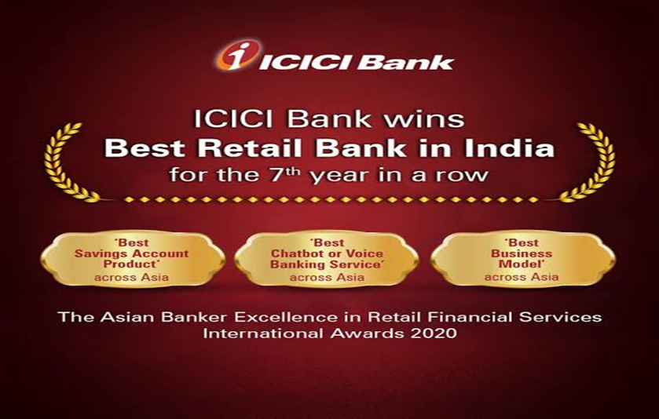
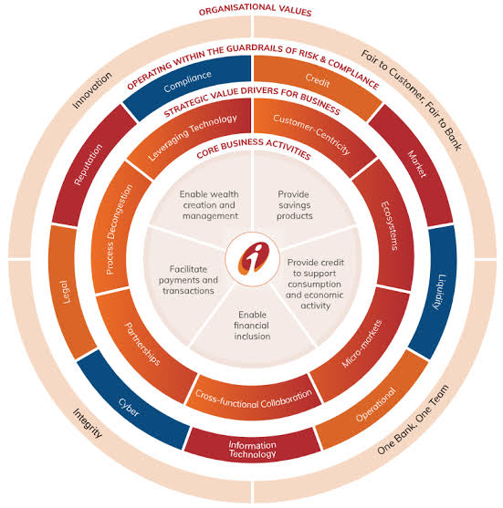
*Share Achievements :
By sharing news about achievements, such as awards and accolades, banks can increase their brand awareness and reach. This can help to attract new customers and build a positive reputation
Sharing achievements on social media is a great way for bank to celebrate milestones and share their success with their followers.
*Awareness Post :
Banks can use awareness posts to promote their commitments to social responsibility and sustainability. This can help to build a positive reputation and attract customers who value these issues.
Awareness posts can be used to promote a bank’s products and services. By explaining the benefits and features of these offerings, bank can attract new business and generate interest.

Slide 28
Marketing strategies of ICICI Bank :
ICICI Bank in India’s second largest bank with total assets of Rs.4062.34 billion at march 31,2011 and profit after tax Rs.51.51 billion for the year ended march 31,2011.
ICICI Bank offers a wide range of banking products and financial services to corporate and retail customers through a variety of delivery channels and through its specialised subsidiaries in the areas of investment banking, life and non-life insurance, venture capital and asset management.
They were first to introduced concept of branding in the Indian banking industry. They were also first in the industry :
*Process, people and physical evidence-brought to life by ICICI
*Product Innovation – various deposits, loans, investment, mobile banking, NRI services offered by bank
*Introduction of DSA’s and DST’s.
*Unleashed the power of the internet.
*First bank to focus on retail banking as a driver for growth.
*Comprehensive data centre availability & data protection solutions.

Slide 29
*Challenges Faced In Content Ideas And Marketing Strategies
*Regulatory Compliance:
Banks operate in a highly regulated industry, and any marketing content must comply with strict financial and banking regulations. This can limit the creative freedom and require a careful review process for all marketing materials to ensure they meet legal requirements.
*Customer Education:
Banking products and services can be complex, and customers may not fully understand them. Creating content that educates customers about various banking offerings in a clear and accessible manner can be challenging.
*Trust and Reputation:
Banks need to maintain a high level of trust with their customers. Any content that could be perceived as misleading or untrustworthy can damage the bank's reputation, so maintaining credibility is vital.
*Competition:
The banking industry is highly competitive, with many banks vying for customers' attention. Creating unique and compelling content to stand out from the competition can be a challenge.
*Data Privacy and Security:
Banks handle sensitive customer data, and ensuring the privacy and security of this information is of utmost importance. Content marketing efforts should be aligned with data protection regulations and address customer concerns about data privacy.

Slide 30
Part 4: Content creation and curation (Post creations, designs/video editing, ad campaigns over social media and email ideation and creation)

Slide 31
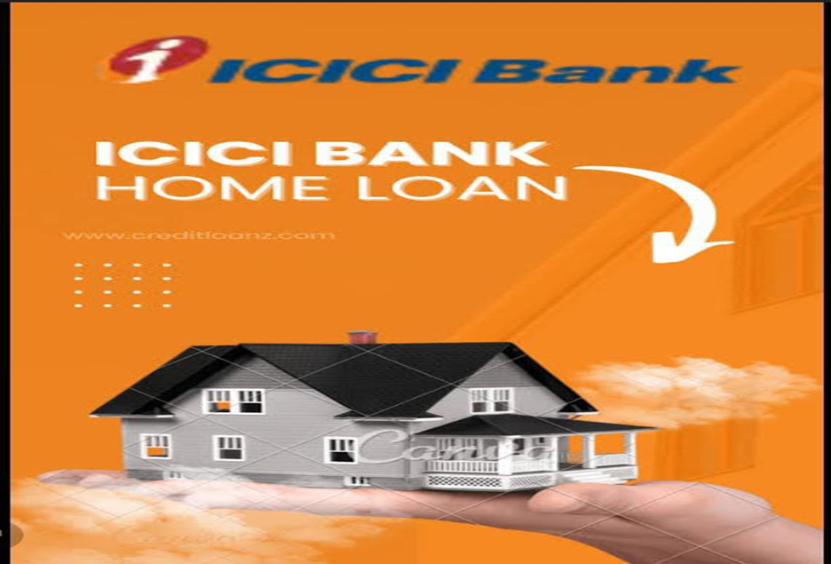
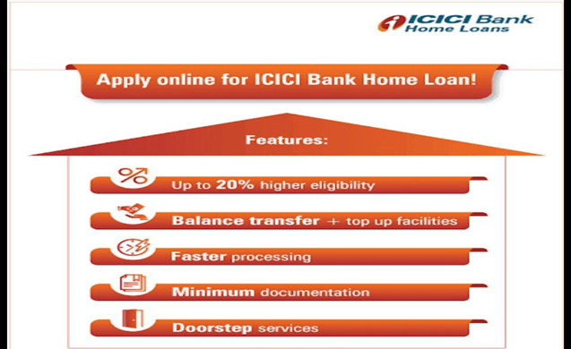
FORMAT 1: CREATIVE
Aim: To aware people about house loans in ICICI bank
Date: 04-08-2023
Idea: To create a relatable and humorous connection with the target audience for home loans

Slide 32
FORMAT 2: BLOG ARTICLE
Aim: Boost SEO and provide information about investing in mutual funds in ICICI Bank
Date: 08-08-2023
Idea: ICICI Bank has introduced mutual funds and this blog will cover the details about investing in mutual funds
Here are some steps to consider if you're interested in investing in mutual funds through ICICI Bank
1. Assess Your Investment Goals: Determine your financial goals, risk tolerance, and investment time horizon. Different mutual funds cater to various objectives, such as wealth creation, income generation, or capital preservation.
2. Research Mutual Fund Options: ICICI Bank offers a variety of mutual funds across different categories, including equity funds, debt funds, hybrid funds, and more. Research the funds' historical performance, expense ratios, and investments strategies to find the ones that align with your goals
3. Consult a Financial Advisor: If you are unsure about which mutual funds to choose, consider consulting a qualified
financial advisor. They can provide personalized advice based on your financial situation
4. Open an Investment Account: If you already have a savings mutual fund account. Alternatively, you may need to open a separate investment account if you don't have one.
5. KYC Compliance: Complete the KYC (Know Your Customer) process as mandated by regulatory authorities. Submit the required documents to verify your identity and address.
6. Select the Mutual Fund(s): Once you have done your research and decided on the mutual funds you want to invest in, you can place an order through ICICI Bank's investment platform. You can choose to invest a lump sum amount or set up a systematic investment plan (SIP) for regular investments

Slide 33
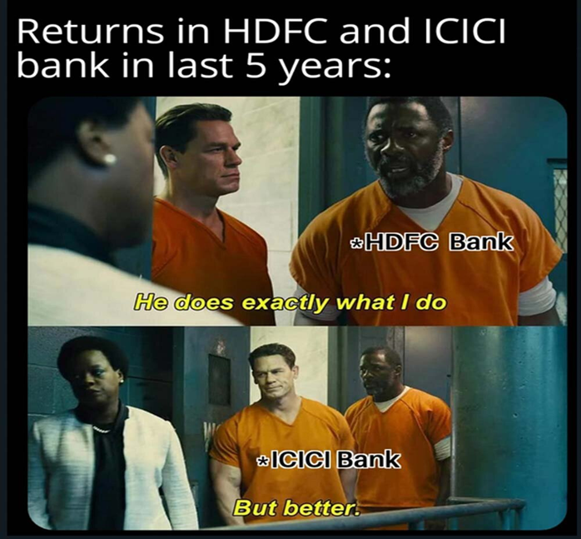
FORMAT 3: CREATIVE MEME
Aim: Brand awareness and reach
Date: 16-08-2023
Idea: To create a meme

Slide 34
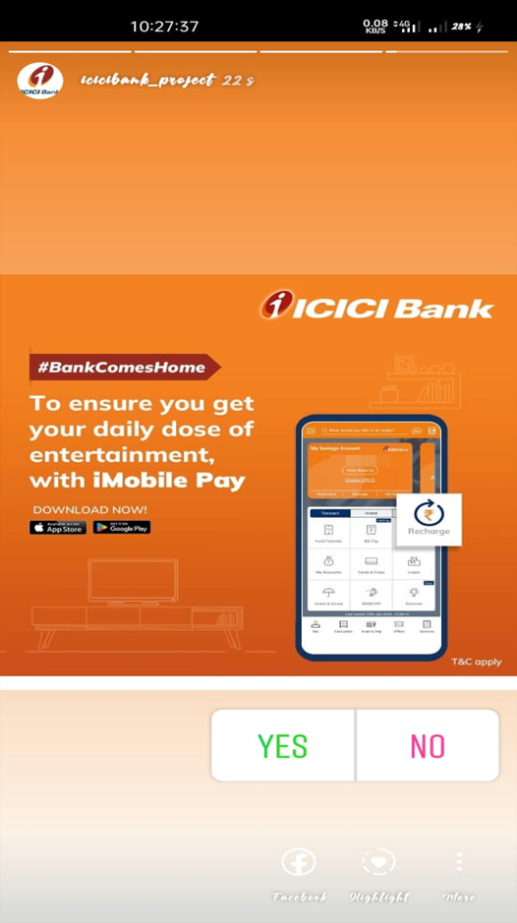
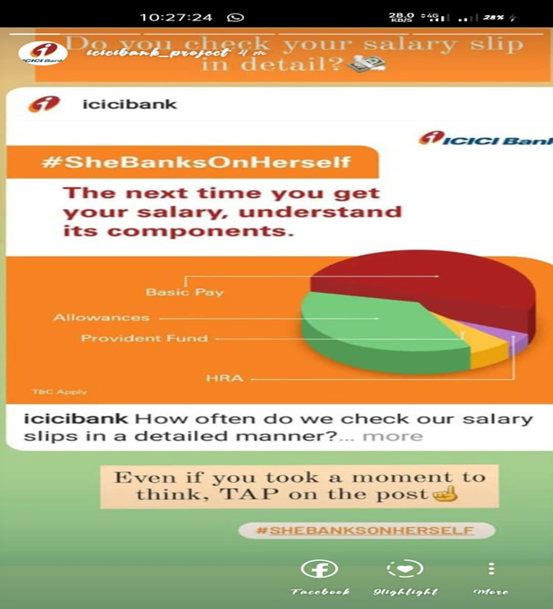
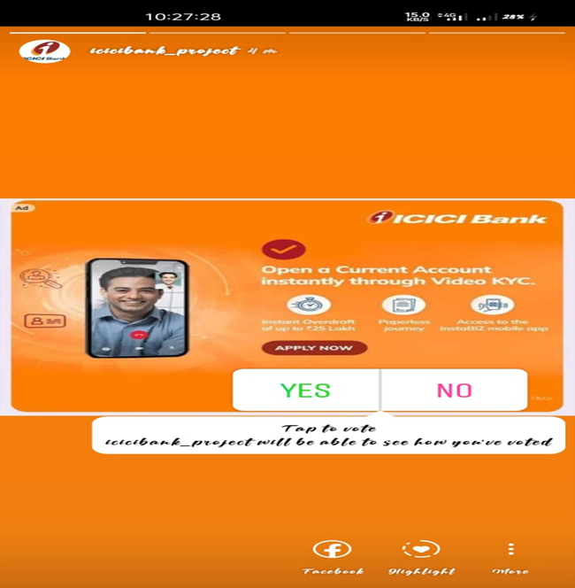
*INSTAGRAM STORY:

Slide 35
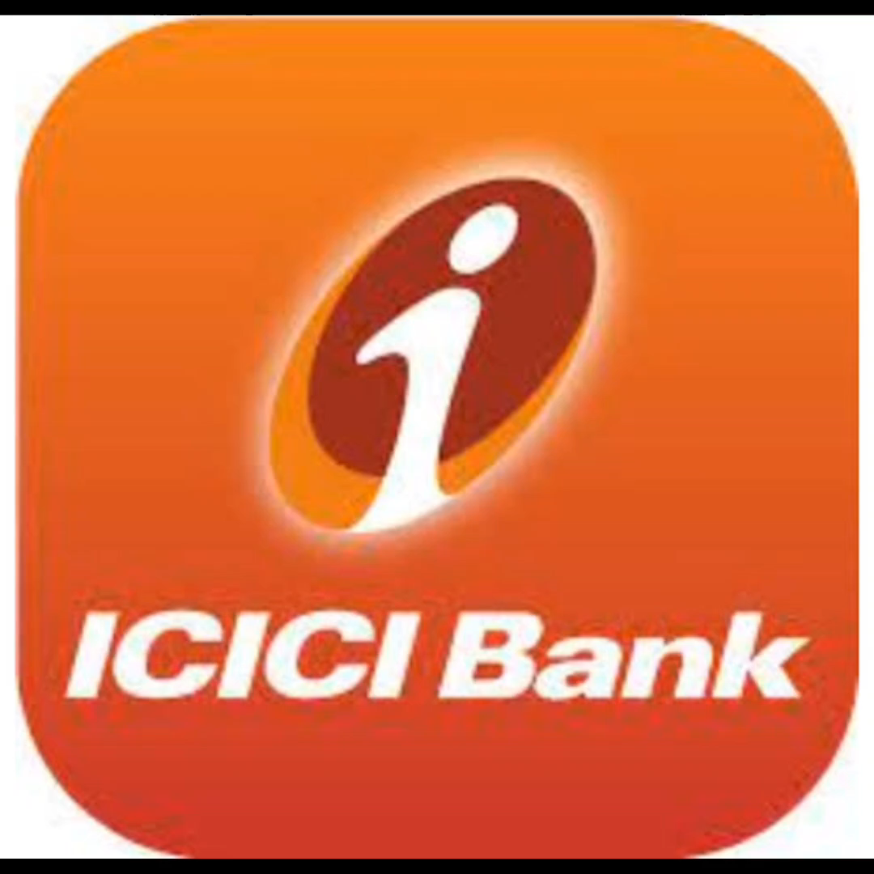
DESIGN/VIDEO EDITING

Slide 36
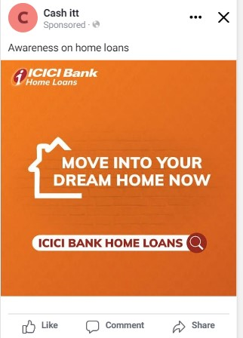
SOCIAL MEDIA AD CAMPAIGNS
BRAND AWARENESS CAMPAIG:
Targeting:
Campaign Objective: Awareness
Location: India
Age: 18-65+
Gender: All genders
Performance Goal: Maximise reach of ads
Interests: Home loans
Primary Text: Make your dream successful

Slide 37
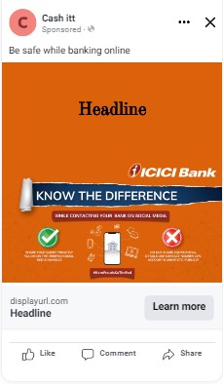
DRIVING WEBSITE TRAFFIC CAMPAIG:
Targeting:
Campaign Objective: Traffic
Location: India
Age: 18-65+
Gender: All genders
Conversion Location: Website
Performance Goal: Maximise number of conversions
Interests: Knowing the difference of sharing our query
Primary Text: While contacting your bank on social media

Slide 38
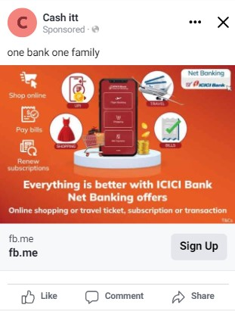
LEAD GENERATION CAMPAIG:
Targeting:
Campaign Objective: Leads
Location: India
Age: 18-65+
Gender: All genders
Conversion Location: Instant forms
Performance Goal: Maximise number of leads
Interests: shop online, pay bills, renew subscription
Primary Text: Net banking offers

Slide 39
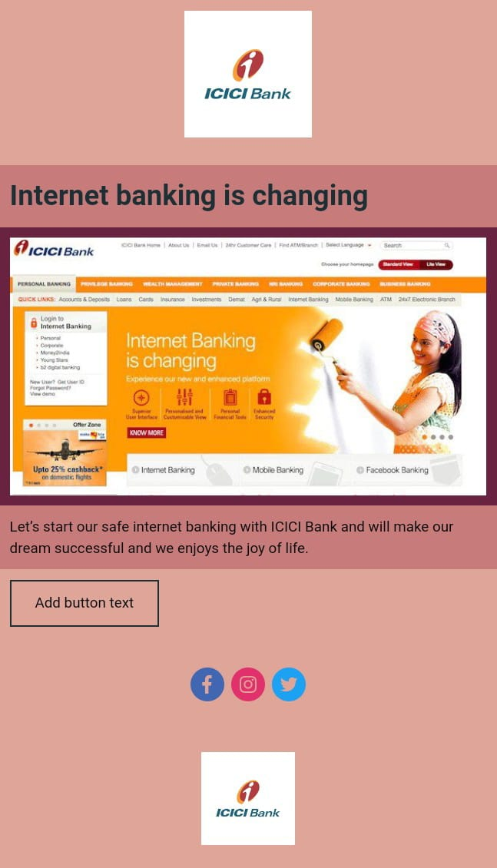
Email Ad Campaigns:
Email Ad Campaign 1 – Brand Awareness

Slide 40
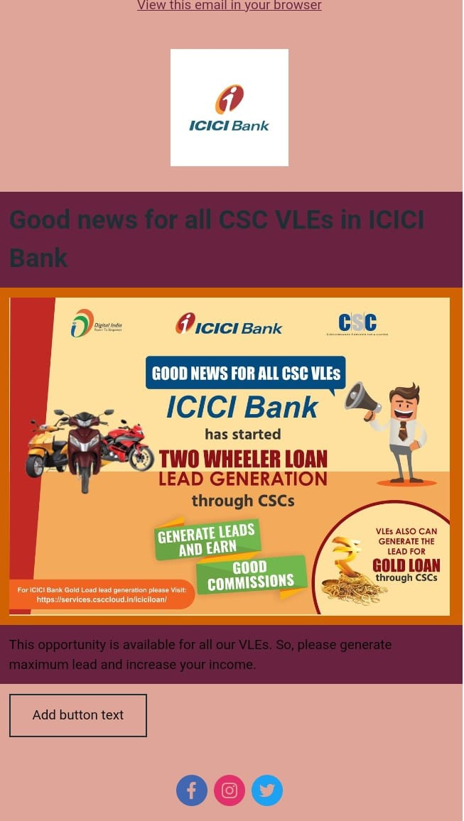
Email Ad Campaigns:
Email Ad Campaign 2 – Lead Generation

Slide 41
THE END

